Slide 1
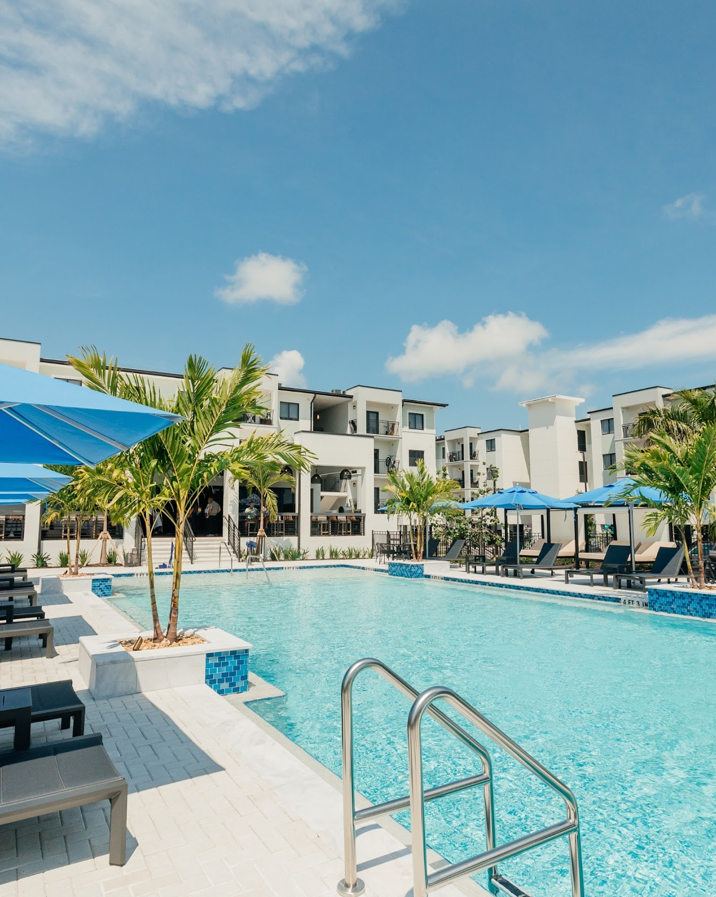

PROPERTY NAME
BROKER OPINION OF VALUE
MONTH/YEAR
PREPARED FOR:
CLIENT NAME
a Berkshire Hathaway and Jefferies Financial Group company

Slide 2

CONTENTS
EXECUTIVE SUMMARY
4
FINANCIAL ANALYSIS
9
SALES COMPARABLES
17
RENTAL MARKET OVERVIEW
19

Slide 3

INVESTMENT ADVISORS
CAPITAL MARKET ADVISORS
Advisor 1
Advisor 1 Title
Advisor 1 Phone
Advisor 1 Email
Advisor 2
Advisor 2 Title
Advisor 2 Phone
Advisor 2 Email
Advisor 3
Advisor 3 Title
Advisor 3 Phone
Advisor 3 Email
Debt Advisor 1
Debt Advisor 1 Title
Debt Advisor 1 Phone
Debt Advisor 1 Email
Analyst 1
Analyst 1 Title
Analyst 1 Phone
Analyst 1 Email
Analyst 2
Analyst 2 Title
Analyst 2 Phone
Analyst 2 Email
Ops Director 1
Ops Director 1 Title
Ops Director 1 Phone
Ops Director 1 Email
Debt Advisor 2
Debt Advisor 2 Title
Debt Advisor 2 Phone
Debt Advisor 2 Email

Slide 4
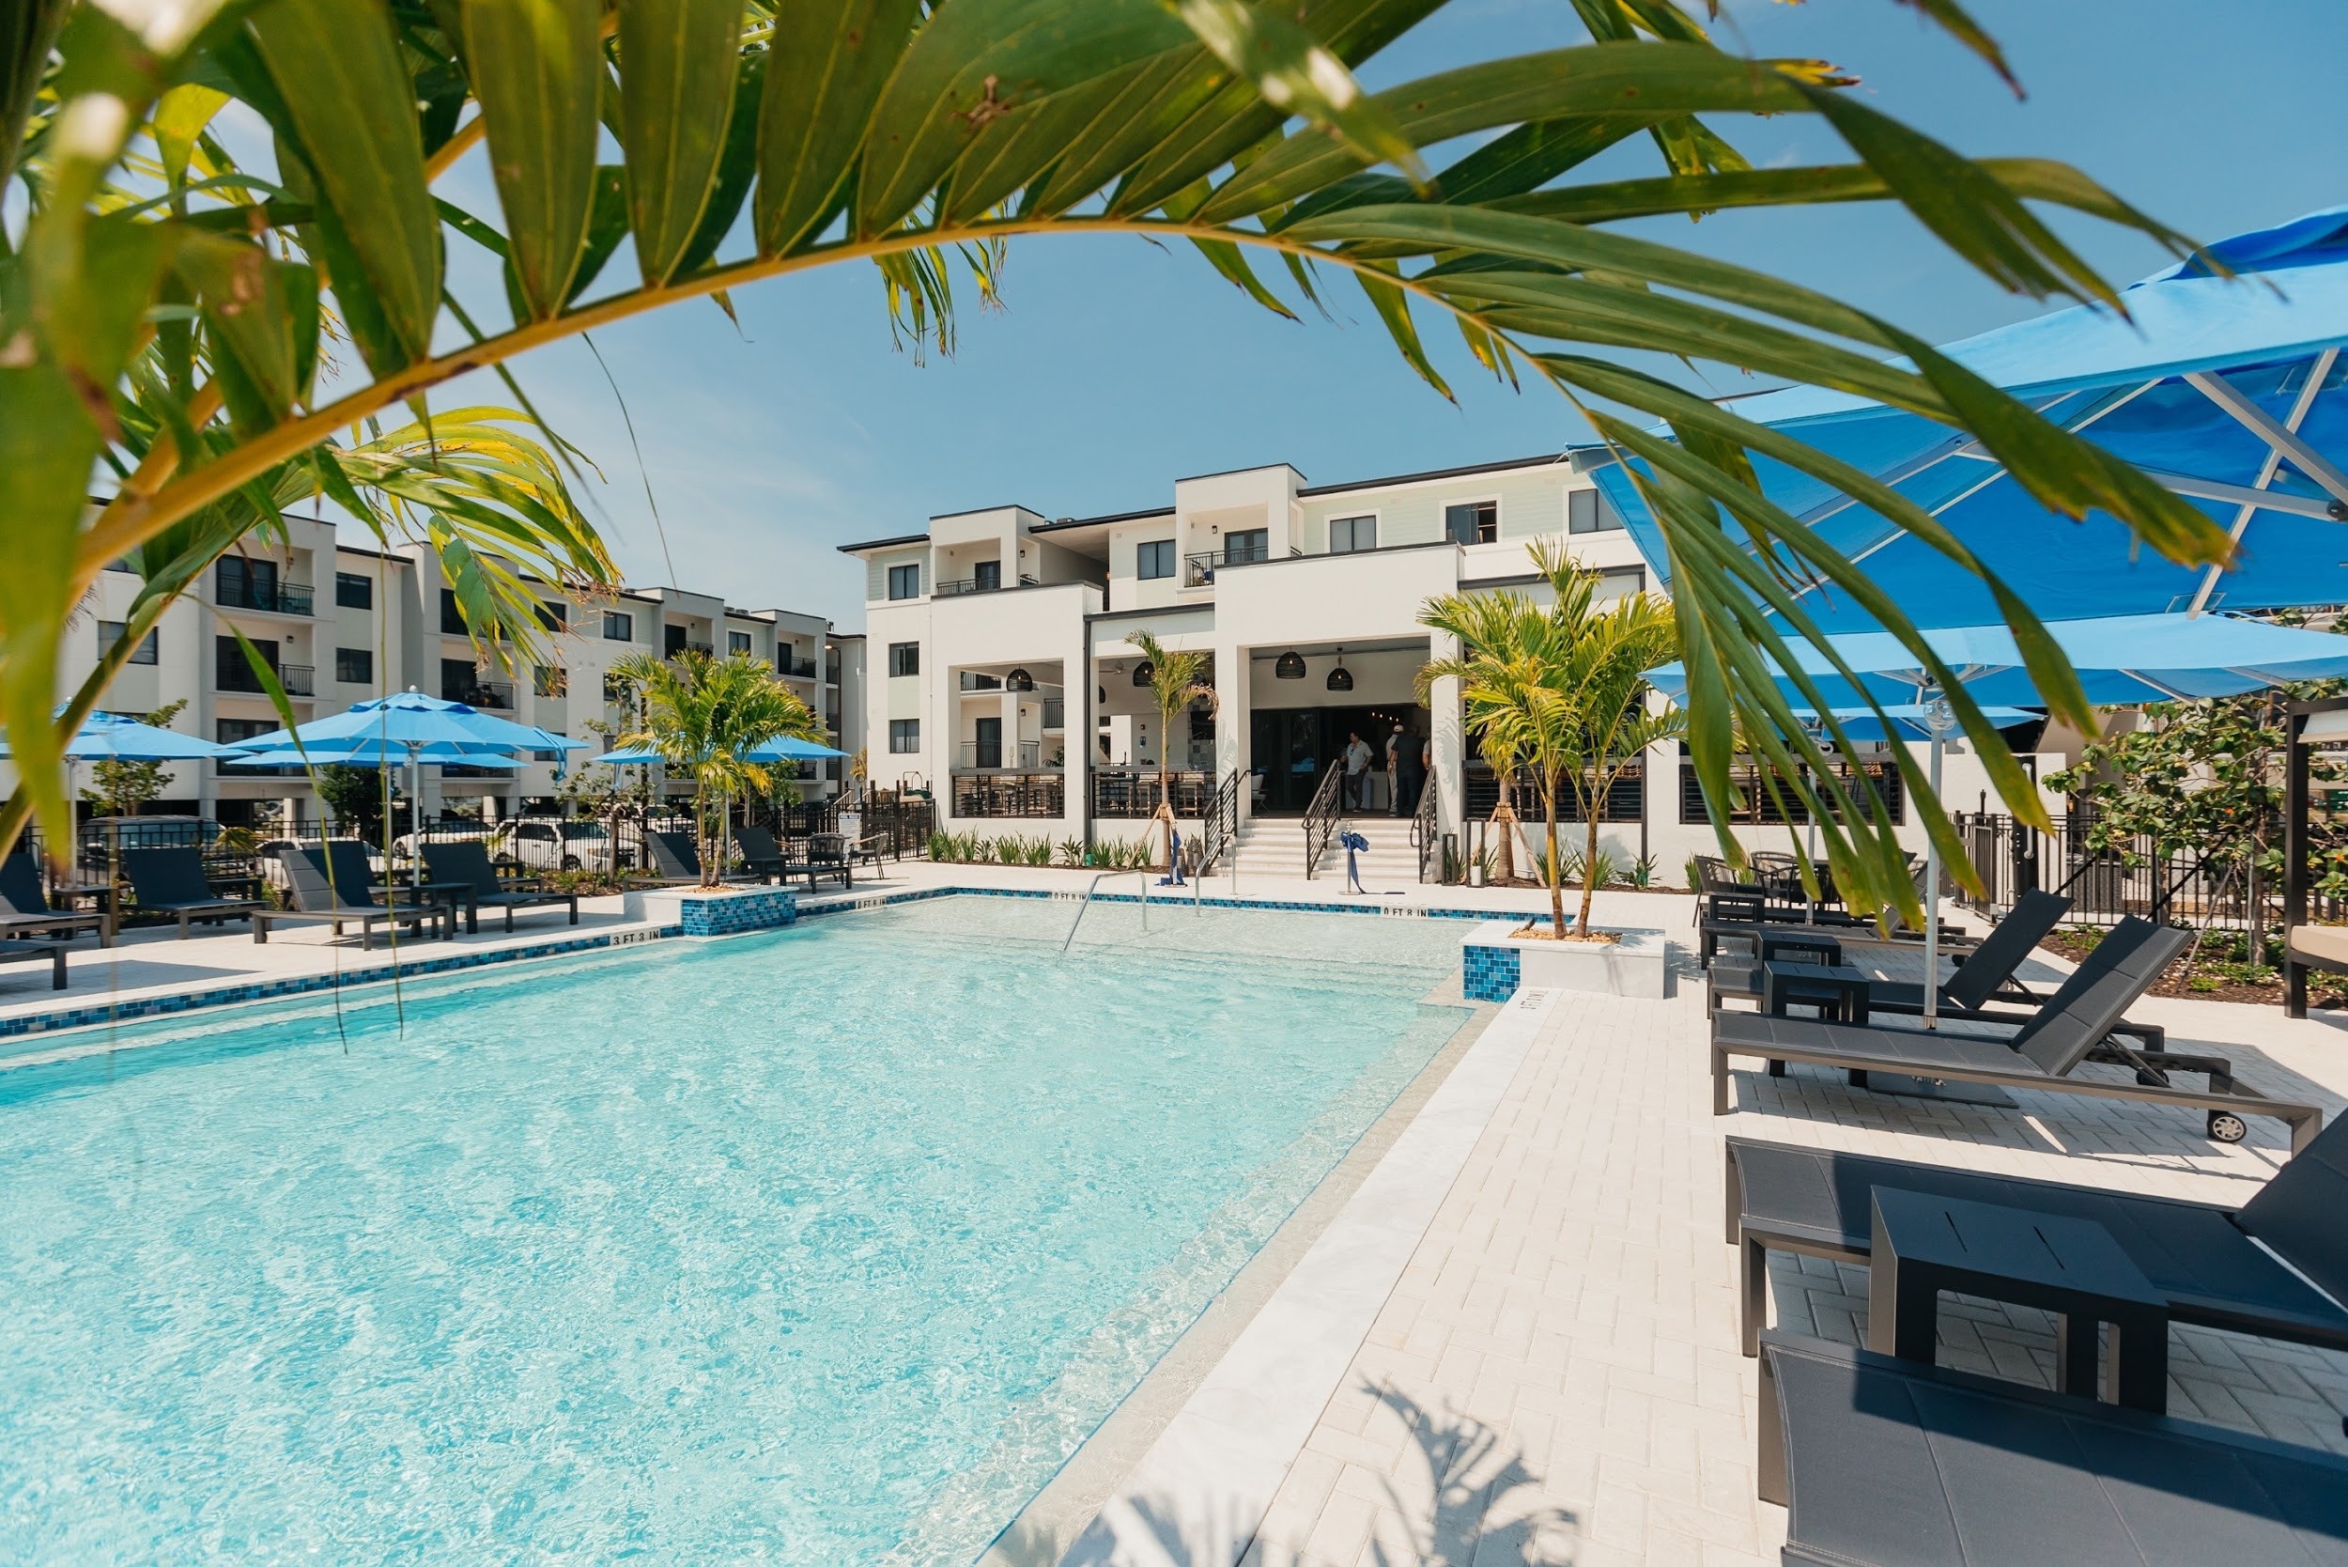
EXECUTIVE SUMMARY

Slide 5
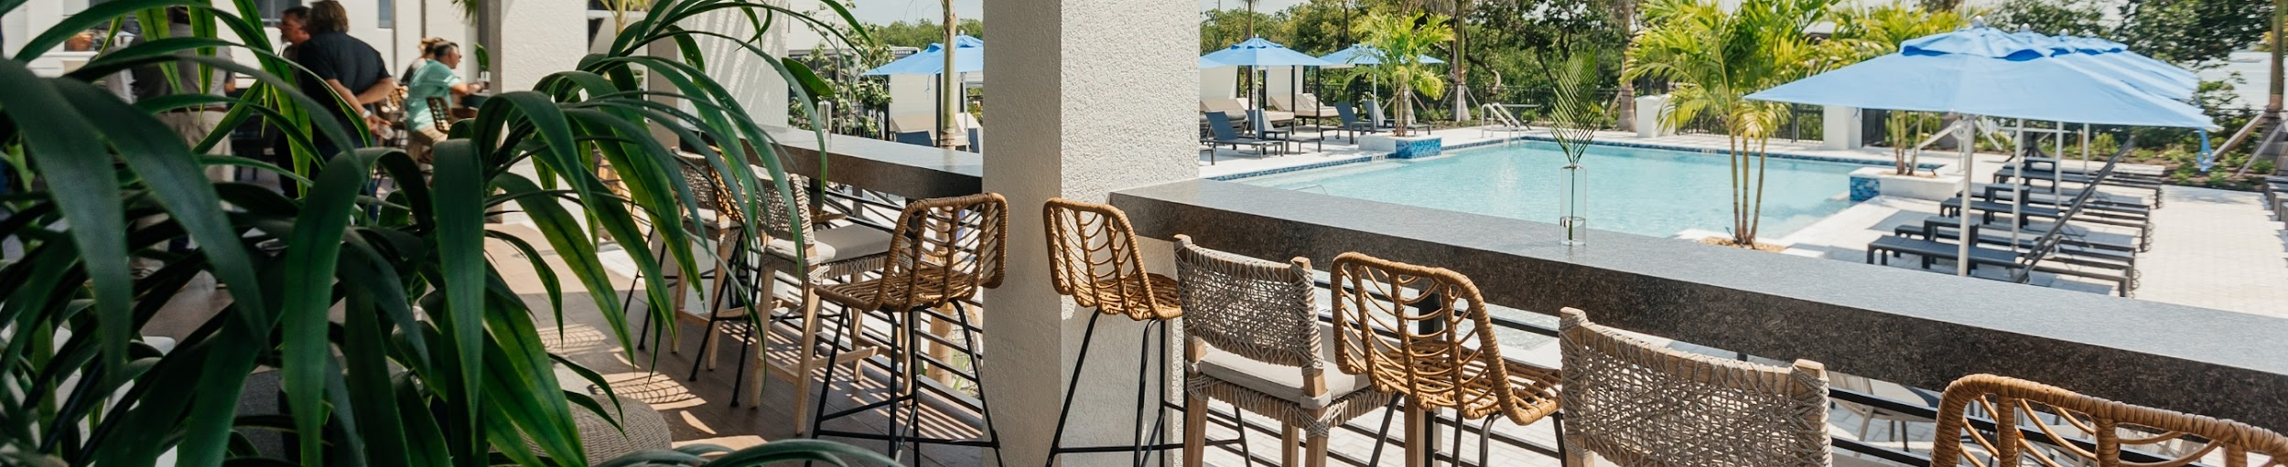
THE ASSIGNMENT
Berkadia Real Estate Advisors (BREA) is excited to present this Broker’s Opinion of Value for PROPERTY NAME (the “Property”). We appreciate the opportunity to discuss the project with CLIENT NAME. The following pages describe BREA’s in depth valuation analysis.
.
SUBMARKET Submarket Name
YEAR BUILT Year Built
UNITS Unit Count
AVG. UNIT SIZE
Avg. SF
COMBINED UNIT MIX
Unit type | Avg. Size (sf) | # Of units | % Of mix | In-Place Rents | In-Place Rents PSF
1 Bedroom | 836 | 279 | 64.4% | $2,055 | $2.46
2 Bedroom | 1,111 | 99 | 22.9% | $2,624 | $2.36
3 Bedroom | 1,684 | 55 | 12.7% | $3,445 | $2.05
Total/Avg | 1,007 | 433 | 100% | $2,359 | $2.34

Slide 6
VALUATION SUMMARY

Slide 7

FINANCIAL ANALYSIS

Slide 8
TRAILING FINANCIALS AND PRO FORMA

Slide 9
PROJECTED CASH FLOW

Slide 10
FINANCIAL FOOTNOTES
Income
Current Effective Rents
This model assumes effective rents will grow by 5.47% in Year 1, from $2,359 to $2,488. We project this rent growth based on the average of the most recent 5 leases per floor plan ($2,416), to which we added 3% organic rent growth. The model also assumes rents will grow 3% from Year 2 onwards.
Loss to Lease
This model assumes 0% Loss to Lease given that units are expected to rent at their market rents.
Vacancy
This model assumes 5% vacancy.
Concessions
This model assumes 0% in concessions.
Non-Revenue Units
This model assumes 2 non-revenue units (0.46%).
Collection Loss
This model assumes a Collection Loss of 0.5% of GPR.
Utility Reimbursements
This model assumes Utility Reimbursements will grow 3% over the T-3.
Other Residential Income
This model assumes Other Income grows 3% annually over the T-12.
Parking & Storage
This model assumes Parking & Storage Income will grow 3% over the T-3.
Expenses
Repairs & Maintenance
This model assumes a Repairs & Maintenance expense of $250, which is in line with the T-12.
Contract Services
This model assumes a Contracted Services expense of $875 per year, which is in line with the T-12.
Turnover & Make-Ready
This model assumes Turnover costs of $250 per unit per year, which is in line with the T-12.
Personnel
This model projects a Payroll expense of $1,600 per unit per year, which is in line with the T-12.
Marketing & Advertising
This model assumes a Marketing & Advertising expense of $225 per unit per year, which is in line with the T-12.
General & Administrative
This model projects a General & Administrative expense of $450 per unit per year, which is in line with the T-12.
Utilities
This model project a Utilities expense of $900 per unit per year, which is in line with the T-12.
Insurance
This model assumes an Insurance expense of $1,900 per unit per year, which is in line with the T-1, and recent insurance rates in South Florida.
Real Estate Taxes
This model reassessed Real Estate Taxes at 80% of the price. In addition, a 4% early payment discount was applied.
Management Fee
This model projects a Management Fee of 3.00% of Effective Gross Income.
Replacement Reserves
This model assumes a Replacement Reserves expense of $250 per unit per year.

Slide 11
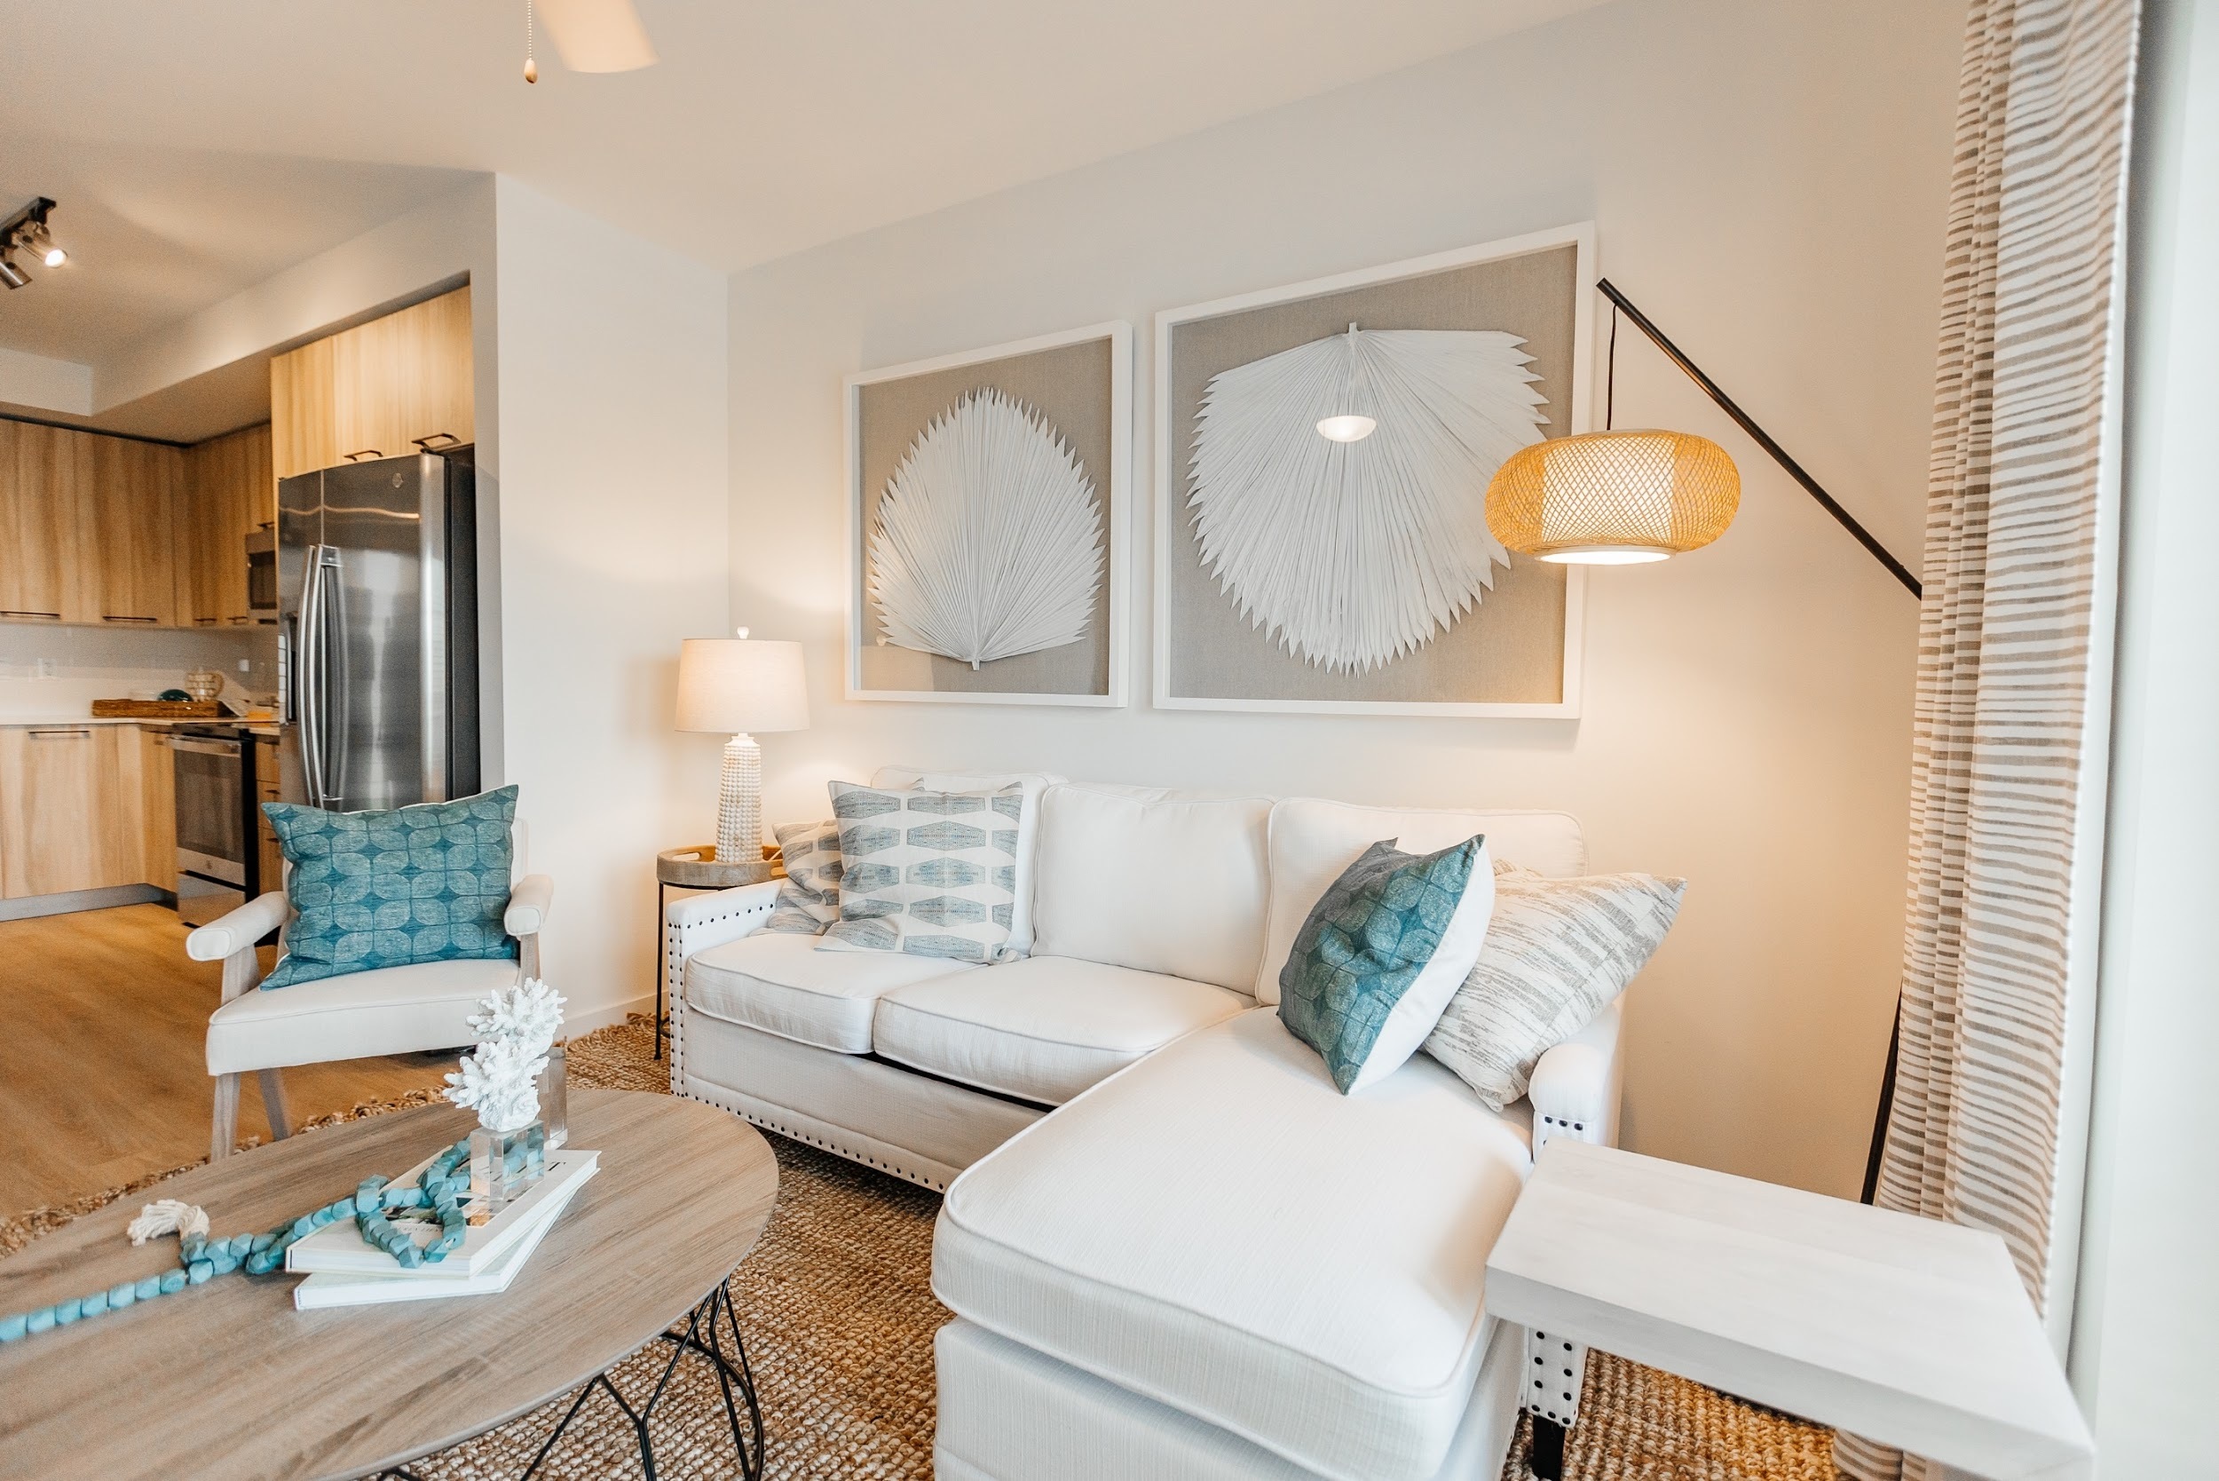
SALES COMPARABLES
Sales Comparables

Slide 12
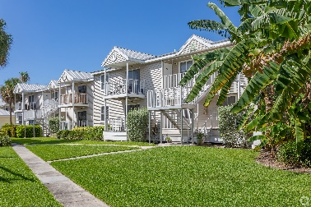
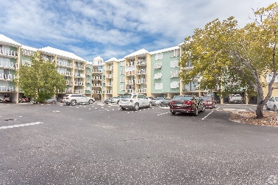
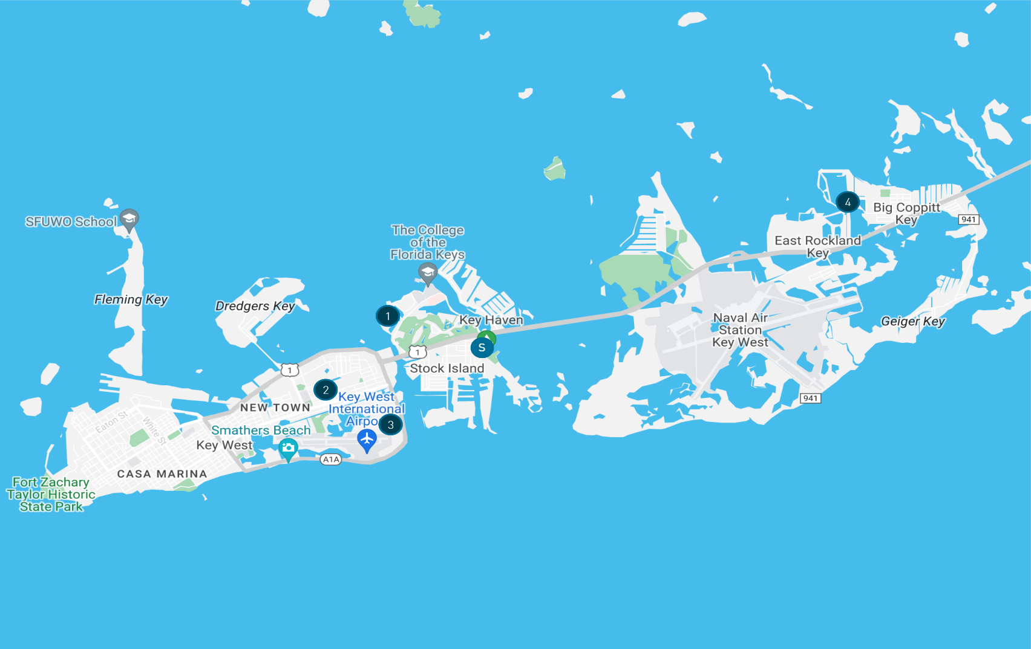
COMPARABLE SALES
 | Property Name | Type | County | Submarket | Sale Date | Built | Units | Unit SF | Rents at Sale | Rents/SF | Sale Price | Price/Unit
1 | Solaire at Coconut Creek Apartments | Garden | Broward | Coconut Creek | Dec-22 | 2014 | 270 | 1,080 | $2,600 | $2.41 | $94,500,000 | $350,000
2 | Bell Miramar | Garden | Broward | Miramar | Dec-22 | 2010 | 131 | 1,124 | $2,643 | $2.35 | $53,570,000 | $408,931
3 | Horizon at Miramar | Garden | Broward | Miramar | Dec-22 | 2008 | 240 | 1,175 | $2,481 | $2.11 | $84,430,000 | $351,792
4 | Lerner Parc at Gatlin Commons | Garden | St. Lucie County | Port St. Lucie | Oct-22 | 2020 | 200 | 1,005 | $2,065 | $2.05 | $65,000,000 | $325,000
5 | Broadstone Cypress Hammocks | Garden | Broward | Coconut Creek | Oct-22 | 2013 | 396 | 1,048 | $2,431 | $2.32 | $132,000,000 | $333,333
6 | High Ridge Landing | Garden | Palm Beach | Boynton Beach | Sep-22 | 2016 | 184 | 1,049 | $2,302 | $2.19 | $71,000,000 | $385,870
7 | Broadstone Cypress Hammocks | Garden | Broward | Coconut Creek | Oct-22 | 2013 | 396 | 1,048 | $2,431 | $2.32 | $132,000,000 | $333,333
8 | High Ridge Landing | Garden | Palm Beach | Boynton Beach | Sep-22 | 2016 | 184 | 1,049 | $2,302 | $2.19 | $71,000,000 | $385,870
Averages |  |  |  |  |  |  |  |  | $2,420 | $2.24 | $83,416,667 | $359,154
1
2
3
4
5
6
7
7

Slide 13
RENTAL COMPARABLES

Slide 14
COMPARABLE SALES
 | Property Name | Type | County | Submarket | Sale Date | Built | Units | Unit SF | Rents at Sale | Rents/SF | Sale Price | Price/Unit
1 | Solaire at Coconut Creek Apartments | Garden | Broward | Coconut Creek | Dec-22 | 2014 | 270 | 1,080 | $2,600 | $2.41 | $94,500,000 | $350,000
2 | Bell Miramar | Garden | Broward | Miramar | Dec-22 | 2010 | 131 | 1,124 | $2,643 | $2.35 | $53,570,000 | $408,931
3 | Horizon at Miramar | Garden | Broward | Miramar | Dec-22 | 2008 | 240 | 1,175 | $2,481 | $2.11 | $84,430,000 | $351,792
4 | Lerner Parc at Gatlin Commons | Garden | St. Lucie County | Port St. Lucie | Oct-22 | 2020 | 200 | 1,005 | $2,065 | $2.05 | $65,000,000 | $325,000
5 | Broadstone Cypress Hammocks | Garden | Broward | Coconut Creek | Oct-22 | 2013 | 396 | 1,048 | $2,431 | $2.32 | $132,000,000 | $333,333
6 | High Ridge Landing | Garden | Palm Beach | Boynton Beach | Sep-22 | 2016 | 184 | 1,049 | $2,302 | $2.19 | $71,000,000 | $385,870
7 | Broadstone Cypress Hammocks | Garden | Broward | Coconut Creek | Oct-22 | 2013 | 396 | 1,048 | $2,431 | $2.32 | $132,000,000 | $333,333
8 | High Ridge Landing | Garden | Palm Beach | Boynton Beach | Sep-22 | 2016 | 184 | 1,049 | $2,302 | $2.19 | $71,000,000 | $385,870
Averages |  |  |  |  |  |  |  |  | $2,420 | $2.24 | $83,416,667 | $359,154
1
2
3
4
5
6
7
7

Slide 15
DISCLAIMER
The material contained in this document is confidential, furnished solely for the purpose of considering investment in the property described therein and is not to be copied and/or used for any purpose or made available to any other person without the express written consent of Berkadia Real Estate Advisors LLC and Berkadia Real Estate Advisors Inc. In accepting this, the recipient agrees to keep all material contained herein confidential.
This information package has been prepared to provide summary information to prospective purchasers and to establish a preliminary level of interest in the property described herein. It does not, however, purport to present all material information regarding the subject property, and it is not a substitute for a thorough due diligence investigation. In particular, Berkadia Real Estate Advisors LLC, Berkadia Real Estate Advisors Inc. and Seller have not made any investigation of the actual property, the tenants, the operating history, financial reports, leases, square footage, age or any other aspect of the property, including but not limited to any potential environmental problems that may exist and make no warranty or representation whatsoever concerning these issues. The information contained in this information package has been obtained from sources we believe to be reliable; however, Berkadia Real Estate Advisors LLC, Berkadia Real Estate Advisors Inc. and Seller have not conducted any investigation regarding these matters and make no warranty or representation whatsoever regarding the accuracy or completeness of the information provided. Any pro formas, projections, opinions, assumptions or estimates used are for example only and do not necessarily represent the current or future performance of the property.
Berkadia Real Estate Advisors LLC and Berkadia Real Estate Advisors Inc. and Seller strongly recommend that prospective purchasers conduct an in-depth investigation of every physical and financial aspect of the property to determine if the property meets their needs and expectations. We also recommend that prospective purchasers consult with their tax, financial and legal advisors on any matter that may affect their decision to purchase the property and the subsequent consequences of ownership.
All parties are advised that in any property the presence of certain kinds of molds, funguses, or other organisms may adversely affect the property and the health of some individuals. Berkadia Real Estate Advisors LLC and Berkadia Real Estate Advisors Inc. recommend, if prospective buyers have questions or concerns regarding this issue, that prospective buyers conduct further inspections by a qualified professional.
The Seller retains the right to withdraw, modify or cancel this offer to sell at any time and without any notice or obligation. Any sale is subject to the sole and unrestricted approval of Seller, and Seller shall be under no obligation to any party until such time as Seller and any other necessary parties have executed a contract of sale containing terms and conditions acceptable to Seller and such obligations of Seller shall only be those in such contract of sale.
For more information on these and other Berkadia® exclusive listings, please visit our website at www.Berkadia.com
Berkadia®, a joint venture of Berkshire Hathaway and Jefferies Financial Group, is an industry leading commercial real estate company providing comprehensive capital solutions and investment sales advisory and research services for multifamily and commercial properties. Berkadia® is amongst the largest, highest rated and most respected primary, master and special servicers in the industry.
© 2021 Berkadia Proprietary Holding LLC
Berkadia® is a trademark of Berkadia Proprietary Holding LLC
Investment sales and real estate brokerage businesses are conducted exclusively by Berkadia Real Estate Advisors LLC and Berkadia Real Estate Advisors Inc. Commercial mortgage loan origination and servicing businesses are conducted exclusively by Berkadia Commercial Mortgage LLC and Berkadia Commercial Mortgage Inc. Tax credit syndication business is conducted exclusively by the Tax Credit Syndication group. In California, Berkadia Real Estate Advisors Inc. conducts business under CA Real Estate Broker License #01931050; Vincent B. Norris, CA BRE Lic. # 843890. Berkadia Commercial Mortgage LLC conducts business under CA Finance Lender & Broker Lic. #988-0701; and Berkadia Commercial Mortgage Inc. under CA Real Estate Broker Lic. #01874116. This proposal is not intended to solicit commercial mortgage loan brokerage business in Nevada. For state licensing details, visit: http://www.berkadia.com/legal/licensing.

